Slide 1
Gagnants
HARIPRAKAASH N
KOKILA M
RAMANIARUNSHAKTHI A

Slide 2
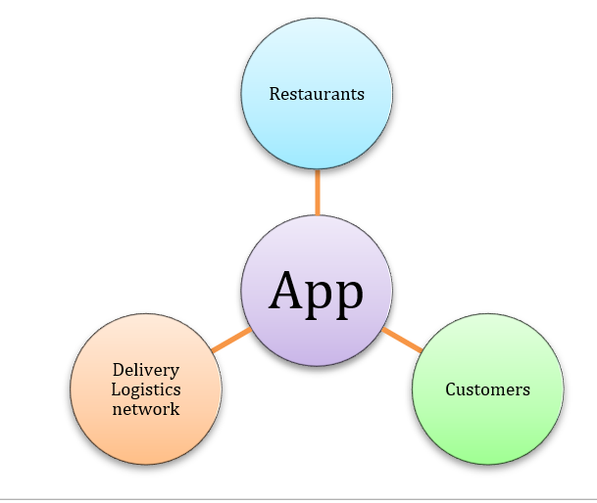
Crowdsourced Support Systems

Slide 3
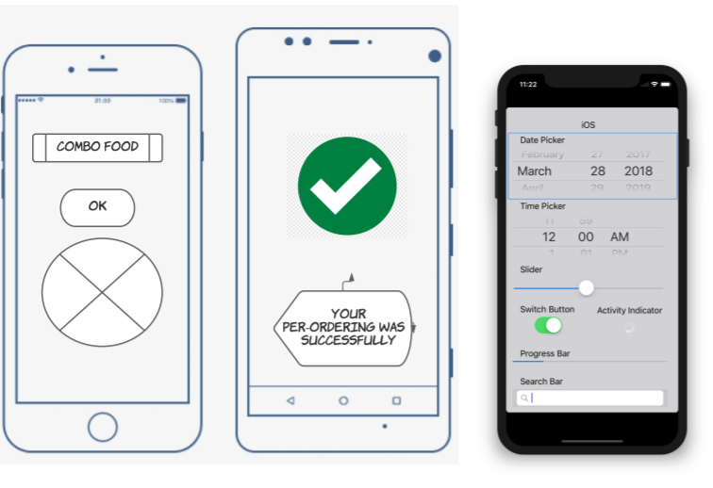

Slide 4
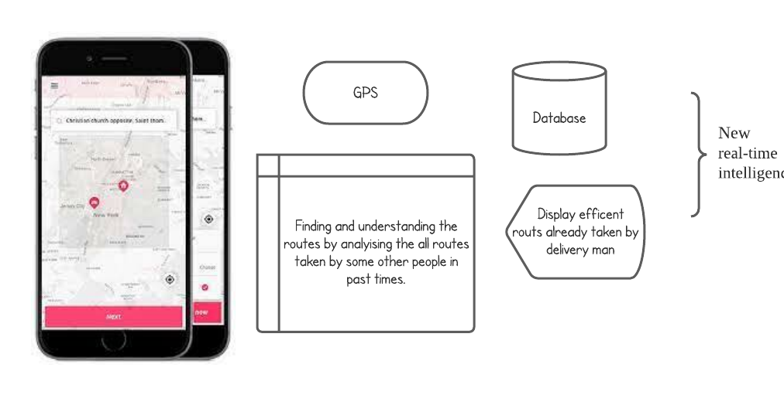

Slide 5
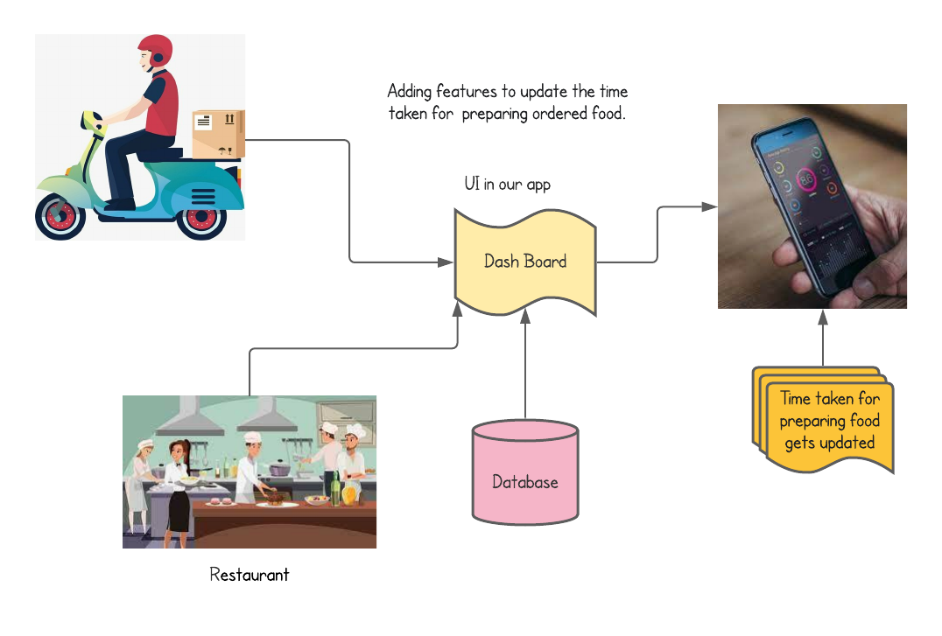

Slide 6
Thank You

